Slide 1
COST Fin AI Country Update: Greece
Dr. Veni Arakelian
Athens, October 2021

Slide 2
MC Members Greece
Dr. Veni Arakelian, MC1, Piraeus Bank, Greece
Prof. Mike Tsionas, MC2, Lancaster University
MC Substitute Members
Prof. Thomas K. Dasaklis, Hellenic Open University & University of Piraeus
Prof. Viki Skintzi, AUEB
Apostolos Chalkis, Quantagonia, ATHENA Research Center, and GeomScale.org
Notes:
2

Slide 3
Other Members
Prof. Ioannis Z. Emiris, ATHENA Research Center, and University of Athens, Greece
Eleni Anastasopoulou, Piraeus Bank, Greece
Paschalis Terzis, Piraeus Bank, Greece
Dr. Vissarion Fisikopoulos, Oracle
Dr. Dimitris Mavridis, Consultant
Dr. Elias Tsigaridas, INRIA & Ecole Polytechnique
Dr. Konstantinos Bisiotis, AUEB
Notes:
3

Slide 4
New Members

Slide 5
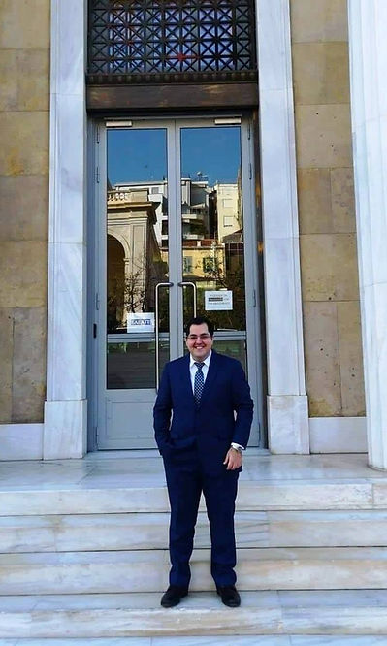
Dr. Dimitris Anastasiou, Alpha Bank
Dimitris is a Senior Economist at Alpha Bank and as an Adjunct Lecturer in Banking and
Finance at the Athens University of Economics and Business.
His main research interests lie around Empirical Banking, Financial Institutions,
Behavioral Finance, and SME Finance. He has published extensively in international
academic journals such as the Journal of Business Research, Journal of Economic
Behavior and Organization, International Journal of Finance and Economics, and
Finance Research Letters.

Slide 6
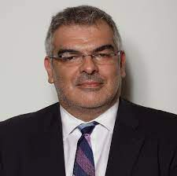
Dr. Theodoros Stamatiou, Eurobank
Theodoros is a Senior Economist in the Economic Analysis & Financial Markets Research Division at Eurobank SA, where he also serves as a Voting Member for the Euro Working Group on Euro Risk-Free Rates and a Member of the Benchmarks Task Force for the European Banking Federation. University of Economics and Business.
His main research interests lie around liquidity, Financial Markets, Financial Risk Management, Asset Pricing and Financial Economics

Slide 7
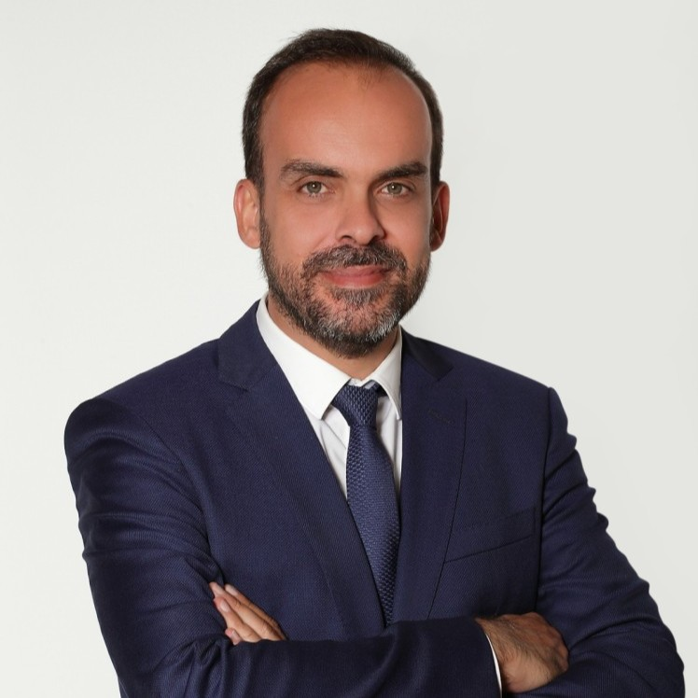
Dr. Stylianos Gogos, Eurobank
Stylianos is a Research Economist in the Economic Analysis & Financial Markets Research Division at Eurobank SA.
Before joining Eurobank he worked as a teaching assistant at the Department of Economics of AUEB and as a lecturer at Mediterranean college (Athens, Greece). He holds a Bsc, Msc, and a PhD in economics from the Department of Economics of AUEB. His research interests focus on quantitative macroeconomics, business cycles and growth.

Slide 8
Dissemination of the Action
Invited talks at University of East Anglia, Armenia State University of Economics, Cyprus University of Technology
New publications
Arakelian V., Central bank digital currency challenges: The case of Greece, Journal of Payments Strategy & Systems 17 (1), 36-45
Malamas V., T. Dasaklis, V. Arakelian, G. Chondrokoukis, A Blockchain Framework for Increased Trust in Green Bonds Issuance, Journal of Sustainable Finance & Investment, forthcoming
Press
Veni Arakelian & Andrea Calef, Banking system interconnectedness, Intelligence Risk, August 2023

Slide 9
Planned Actions
Organize e-seminars and workshops
Collaboration with other research communities
Notes:
9

